Slide 1
Interactions in communities

Slide 2
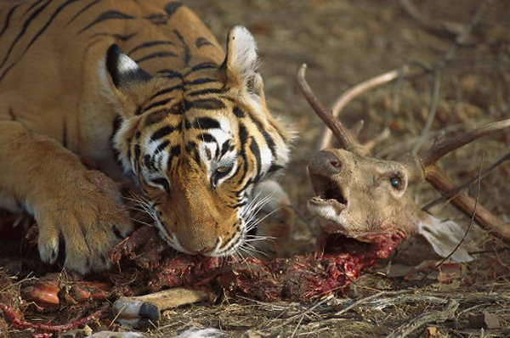
Interactions in communities
Predation – an interaction between two organisms in which the organism, the predator, kills and feeds on the other organism, the prey
https://www.youtube.com/watch?v=ffcyVpqn9ng

Slide 3
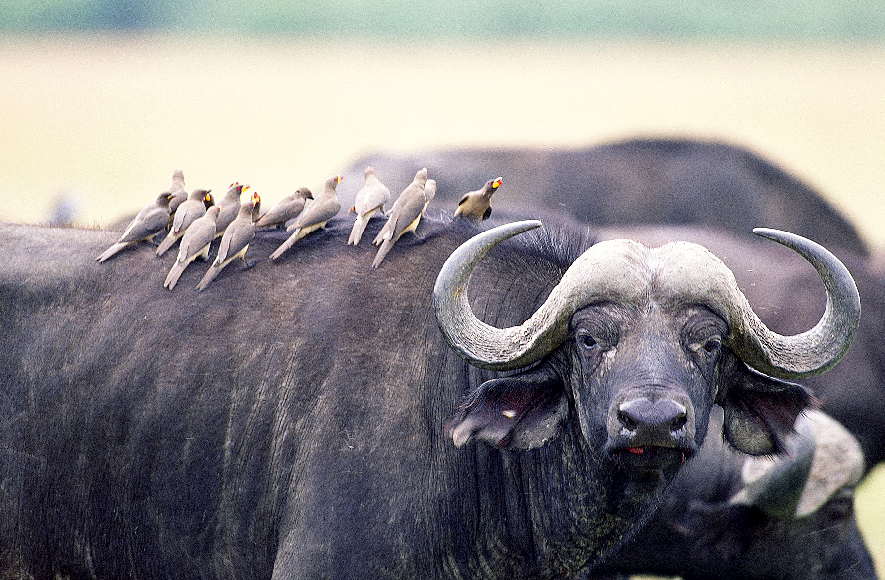
Interactions in communities
Symbiosis – a relationship in which two different species live in close association with each other
https://www.youtube.com/watch?v=8bFSR_4PmCk

Slide 4
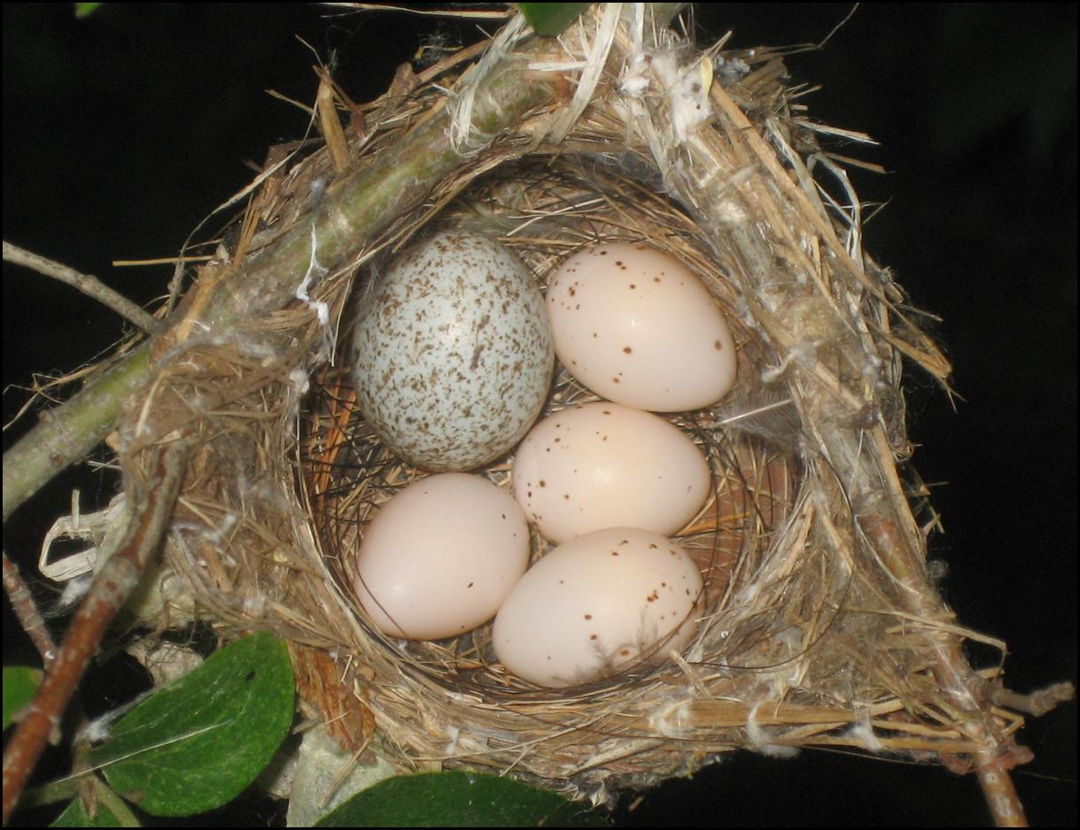
Interactions in communities
Parasitism – a relationship between two species in which one species, the parasite, benefits from the other species, the host, which is harmed

Slide 5
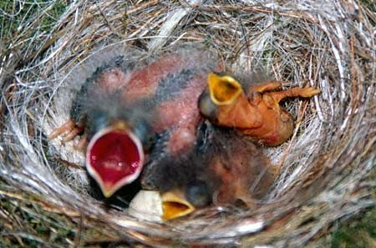
Interactions in communities
Parasitism – a relationship between two species in which one species, the parasite, benefits from the other species, the host, which is harmed

Slide 6
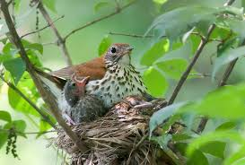
Interactions in communities
Parasitism – a relationship between two species in which one species, the parasite, benefits from the other species, the host, which is harmed

Slide 7
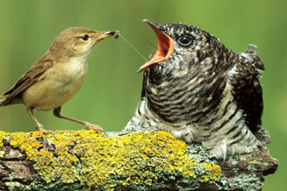
Interactions in communities
Parasitism – a relationship between two species in which one species, the parasite, benefits from the other species, the host, which is harmed

Slide 8
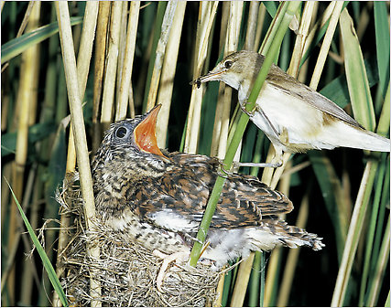
Interactions in communities
Parasitism – a relationship between two species in which one species, the parasite, benefits from the other species, the host, which is harmed
https://www.youtube.com/watch?v=SO1WccH2_YM

Slide 9
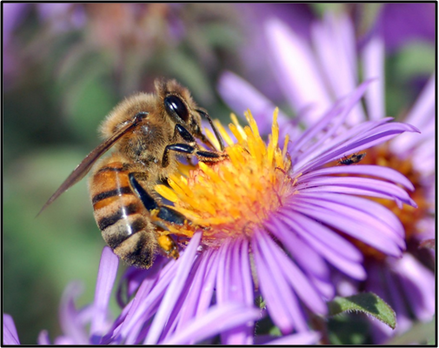
Interactions in communities
Mutualism – a relationship between two species in which both species benefit

Slide 10
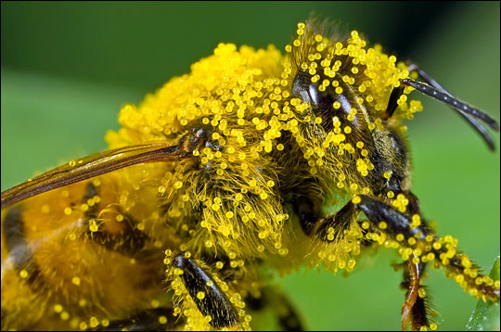
Interactions in communities
Mutualism – a relationship between two species in which both species benefit
https://www.youtube.com/watch?v=Y5uRVv7GGQM

Slide 11
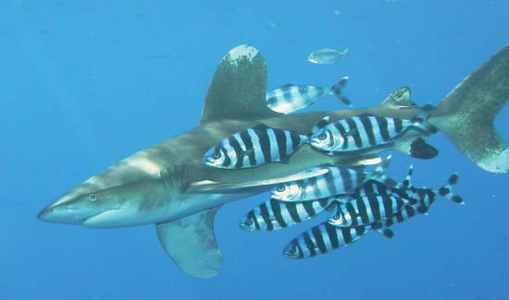
Interactions in communities
Commensalism – a relationship between two organisms in which one organism benefits and the other is unaffected

Slide 12
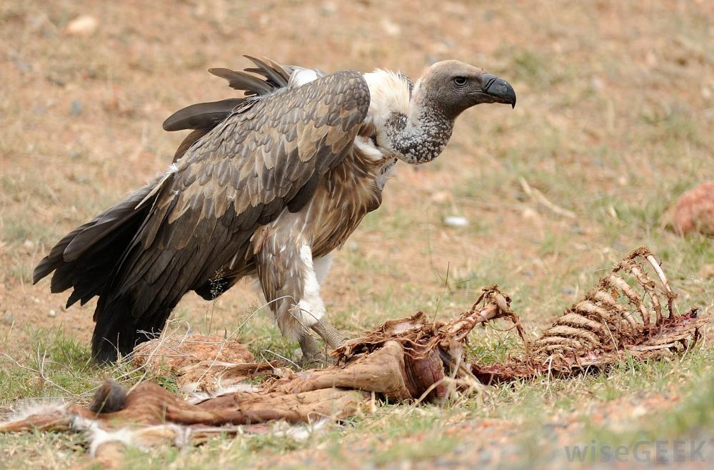
Populations
Niche – the unique position occupied by a species, both in terms of its physical use of its habitat and its function within an ecological community

Slide 13
Competition Videos
Battle at Kurger
https://www.youtube.com/watch?v=LU8DDYz68kM
Strikes back
https://www.youtube.com/watch?v=4oSTSV9EvAU
Combat
https://www.youtube.com/watch?v=N_7n83TEEAk https://www.youtube.com/watch?v=cHYurKQ_bq0
Humans as predators
https://www.youtube.com/watch?v=wJiZ2HgV5E0

