Slide 1
Quick Write
List the planets from closest to the sun to the farthest
Pluto (A planet IMO!)
Uranus
Saturn
Mars
Earth
Neptune
Jupiter
Venus
Mercury

Slide 2
Quick Write
List the planets from closest to the sun to the farthest
Mercury
Venus
Earth
Mars
Jupiter
Saturn
Uranus
Neptune
Pluto (A planet IMO!)

Slide 3
Evidence of how life began
Is there scientific evidence for the origin of life on Earth?

Slide 4
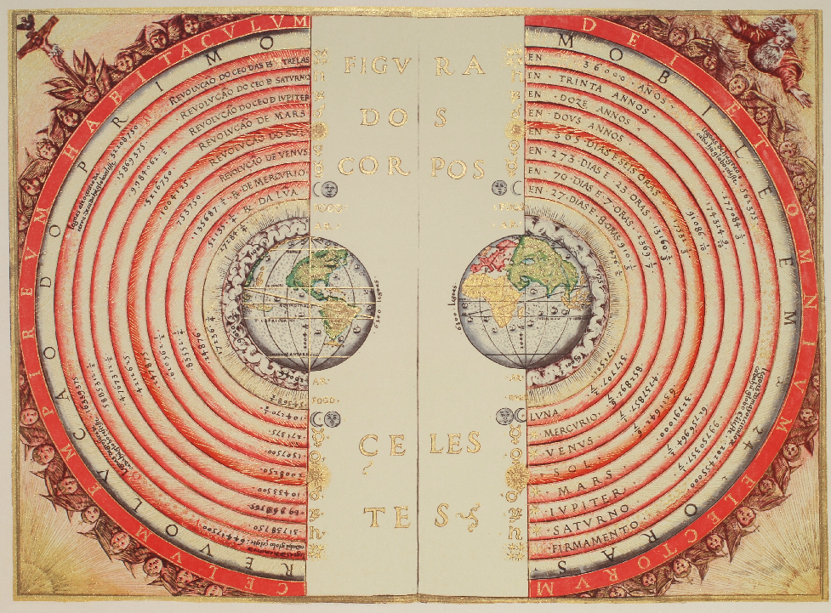
Notes:
An old understanding of our solar system

Slide 5
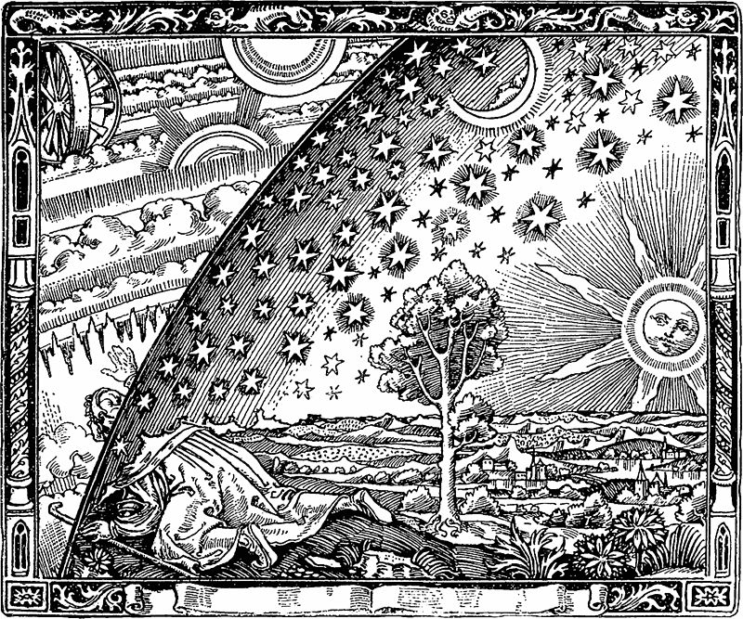
Notes:
An old understanding of our plant

Slide 6
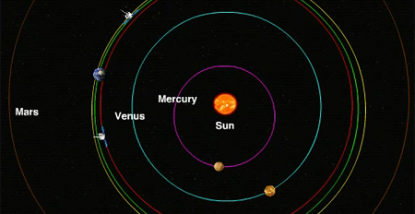
Notes:
Our current understanding of our sol

Slide 7
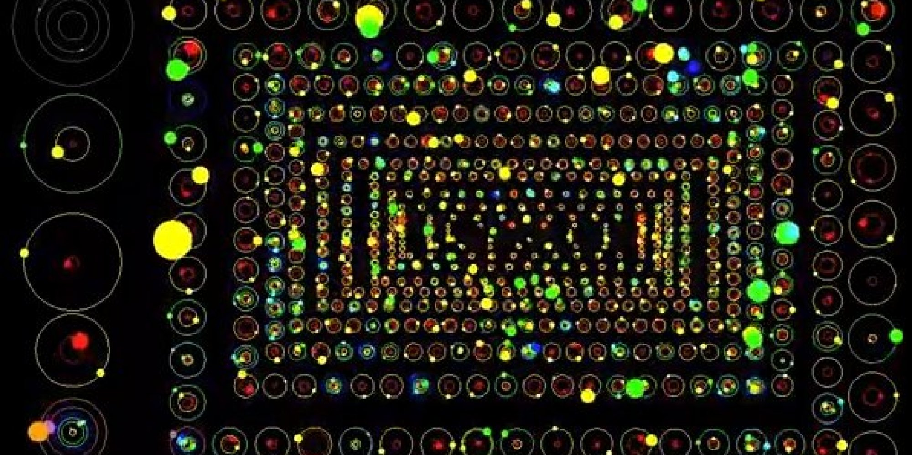
Notes:
Nasa has mapped thousands of solar systems

Slide 8
How did life begin?
Is there scientific evidence for the origin of life on Earth?

Slide 9
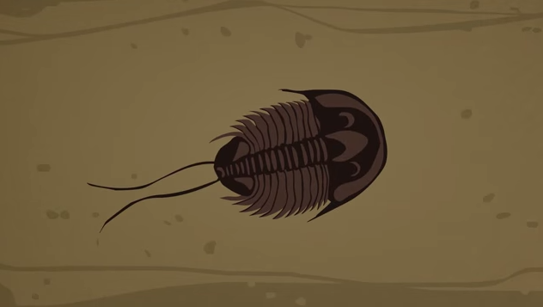
Origins
https://www.youtube.com/watch?v=fgQLyqWaCbA

Slide 10
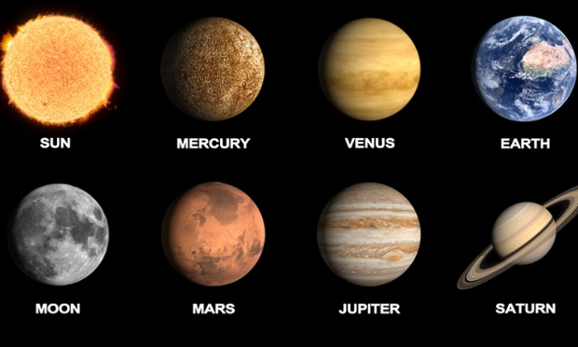

Slide 11
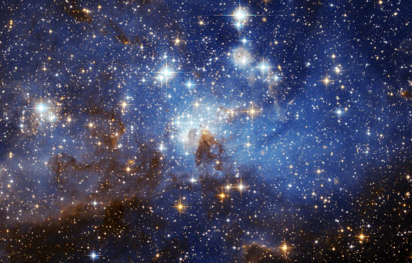
Notes:
The Universe is HUGE!

Slide 12
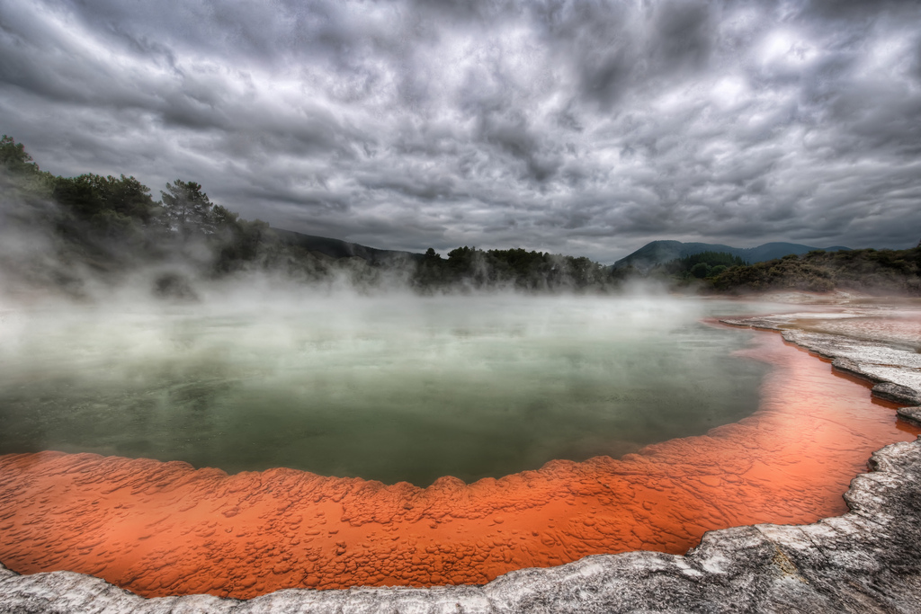
Notes:
Life in extreme environments

Slide 13
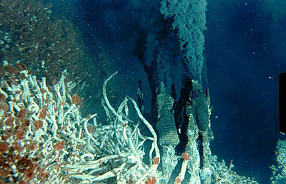
Notes:
Life in extreme environments

Slide 14
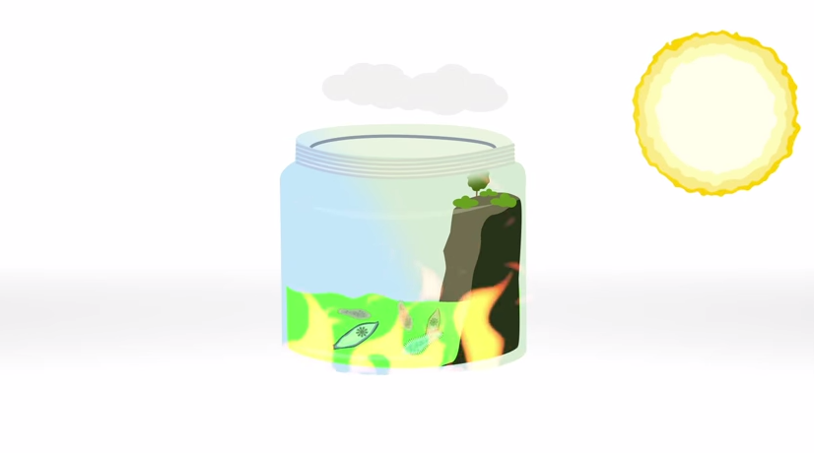
Why extremophiles bode well for life beyond Earth
https://www.youtube.com/watch?v=Bsp5JYNMAQE

Slide 15
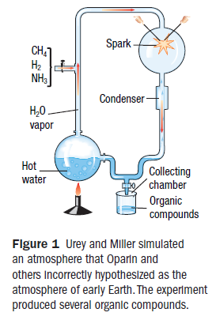
Basic chemicals of life
Miller-Urey experiment – showed that under certain conditions, organic compounds could form from inorganic molecules

Slide 16
Life’s building blocks
Early biological molecules could have formed close to hydrothermal vents.

Slide 17
Life’s building blocks
Early biological molecules could have formed close to hydrothermal vents.
Hydrothermal vents produce heat energy for chemical reactions.
Under water, the molecules would have been protected from potentially harmful solar radiation

Slide 18
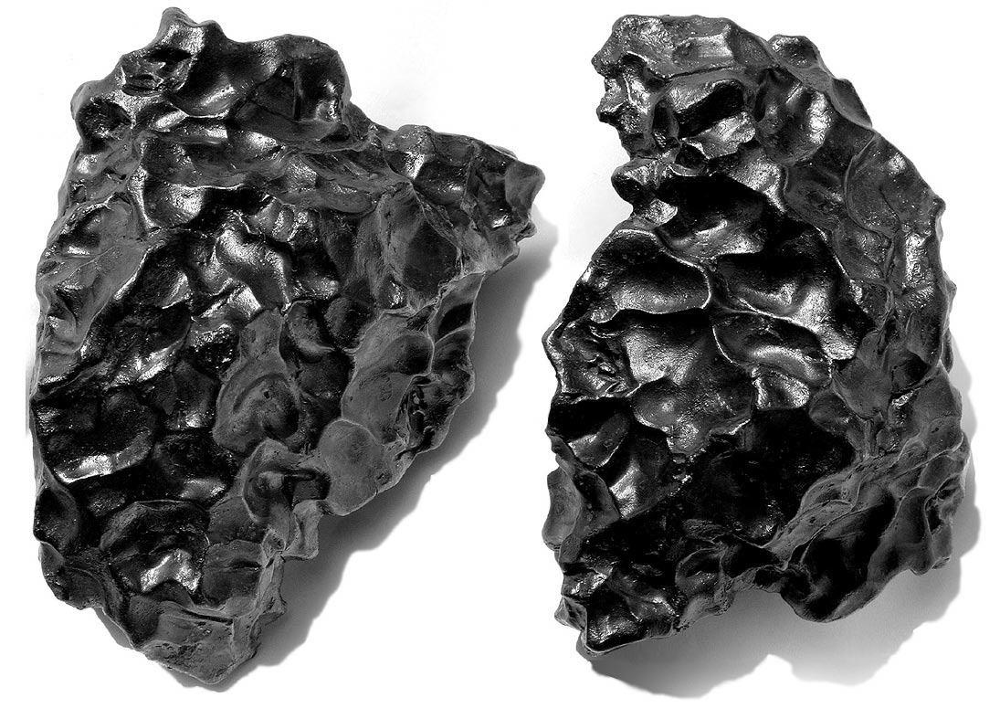
Life’s building blocks
Organic molecules could have arrived on Earth on meteorites or comets
Meteorite impacts were more frequent in the early history of Earth than they are now.

Slide 19
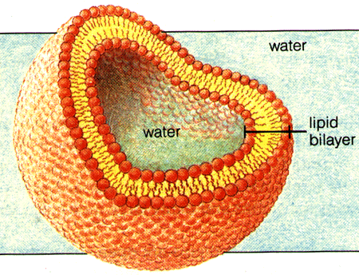
Cell membrane
Phospholipids chemically come together to make microspheres
Many scientists think that the formation of microspheres may have been the first step toward cellular organization

Slide 20
Fossil Record
Fossil Record – the history of life in the geologic past as indicated by the traces or remains of living things

Slide 21
Fossil Record
Both the geographical distribution of organisms and when they lived on Earth can be inferred from the fossil record
Relative dating – a method of determining whether an even or object, such as a fossil, is older or younger than other events or objects

Slide 22
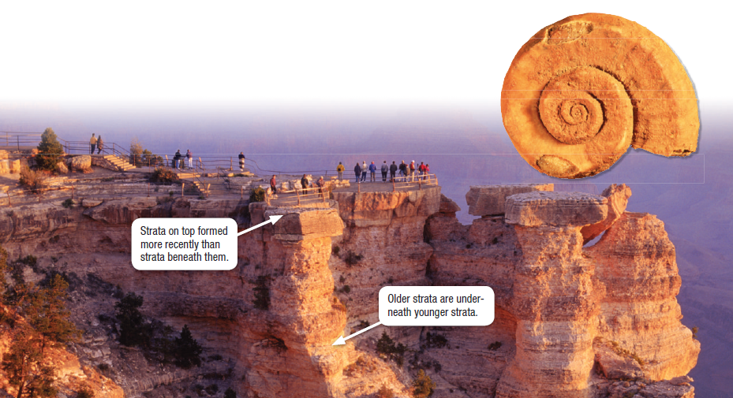
Relative dating

Slide 23
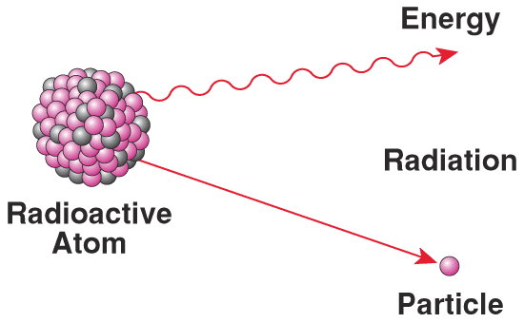
Absolute age
Radiometric dating – a method of determining the absolute age of an object, often by comparing the relative percentages of a radioactive (percent) isotope and a stable (daughter) isotope
Half-life – the time required for half of a sample of radioactive substance to decay

Slide 24
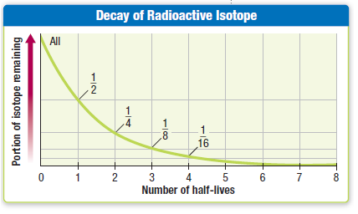
Absolute age

Slide 25
Absolute age - example
Mummified remains contain the organic material Carbon-14
The half life of carbon-14 is relatively short: 5730 years
Remains that have 25% of their original Carbon-14 have undergone how many half-lives?
2 half lives
5730 * 2 = 11460 years old

Slide 26
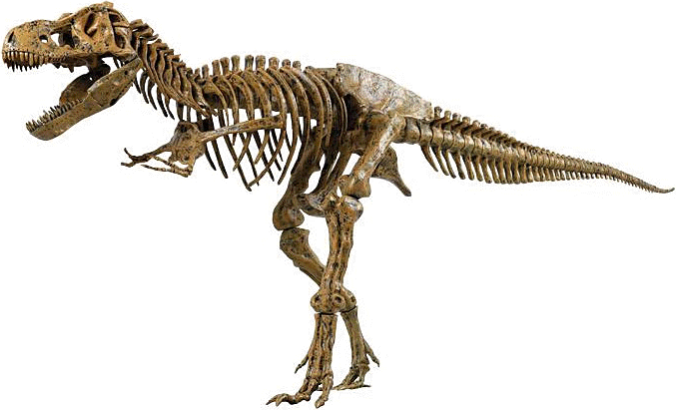
Extinction

Slide 27
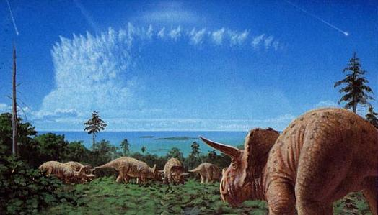
Extinction
Mass extinction – an episode during which large numbers of species become extinct

Slide 28
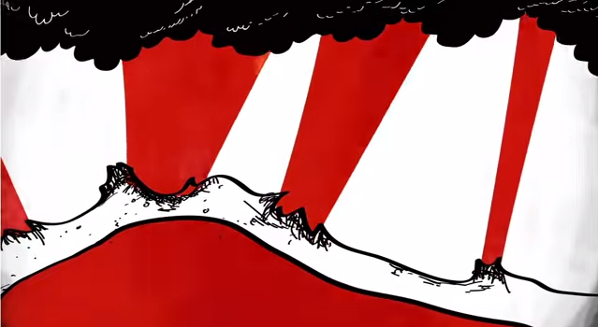
Extinction
https://www.youtube.com/watch?v=hDNlu7Qf6_E

Slide 29
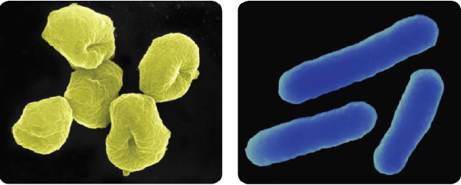
Precambrian Time
Prokaryotes are single-celled organisms that lack membrane-bound organelles
The oldest fossils are microscopic fossils of prokaryotes

Slide 30
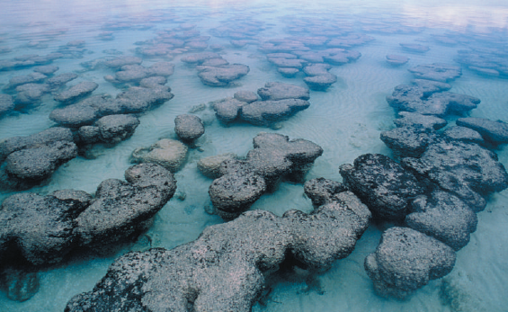
Formation of oxygen
Cyanobacteria – bacteria that carry out photosynthesis; blue-green algae

Slide 31
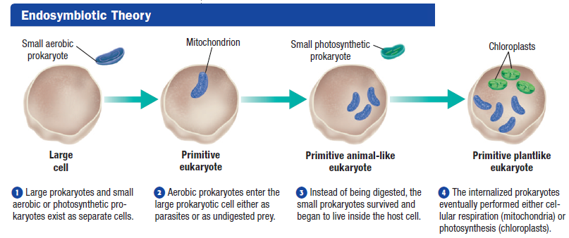
Endosymbiosis
Endosymbiosis – a mutually beneficial relationship in which one organism lives within another

Slide 32
Energy-releasing organelles
Size and Structure
Mitochondrion are the same size and structure as most bacteria
Chloroplasts are the same size as some cyanobacteria

Slide 33
Energy-releasing organelles
Genetic Material
Both chloroplasts and mitochondria contain genes that are different from those found in the nucleus of the host cell
These genes are closely related to bacterial genes

Slide 34
Energy-releasing organelles
Reproduction
Like bacteria, chloroplasts and mitochondria reproduce by simple binary fission.
This replication takes place independently of the cell cycle of the host cell

Slide 35
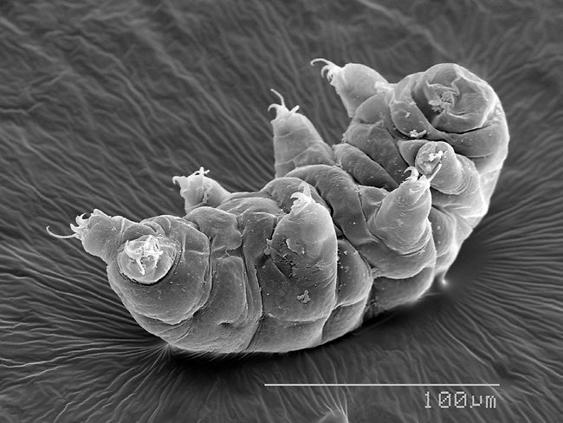
Tardigrades as Astronauts?
https://www.youtube.com/watch?v=EnnPJXbKt0U

Slide 36
Evidence?
https://www.youtube.com/watch?v=lIEoO5KdPvg

Slide 37
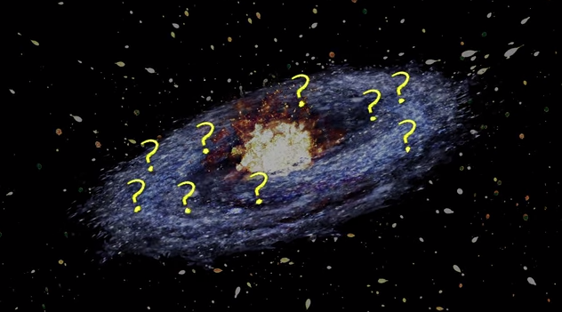
Drake equation – Life on other Plants?
https://www.youtube.com/watch?v=6AnLznzIjSE

